Slide 1
Mystical Forest Adventure

Slide 2
Game Introduction
Base Game Format
Reel Layout:- 3*5
Payline:- 20 (fixed)
Min Bet:- 0.10
Max Bet:- 25.00
Theme:- Mystical Forest Adventure
Symbols:- 4 High, 5 Low, Wild, Bonus, Scatter
Pay-Table
Symbols | 3s | 4s | 5s
Wild | 1x | 10x | 20x
High 1 | 1x | 10x | 20x
High 2 | 0.8x | 6x | 16x
High 3 | 0.6x | 4x | 12x
High 4 | 0.4x | 2x | 8x
Low 1-5 | 0.3x | 1.2x | 3x

Slide 3
Game Mechanics
Base Game
3*5 slot game with 20 fixed pay-line.
Land any symbol 3 or more of a kind to trigger a win.
All wins pay left to right on adjacent reels (except Scatter).
Winning combinations begin with the left most reel.
Only highest win paid per selected line.
Wild participates in all win except Scatter/Bonus.

Slide 4
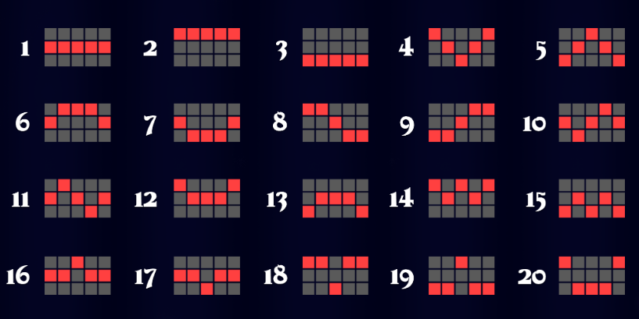
Pay-Line

Slide 5

Base Game Background

Slide 6

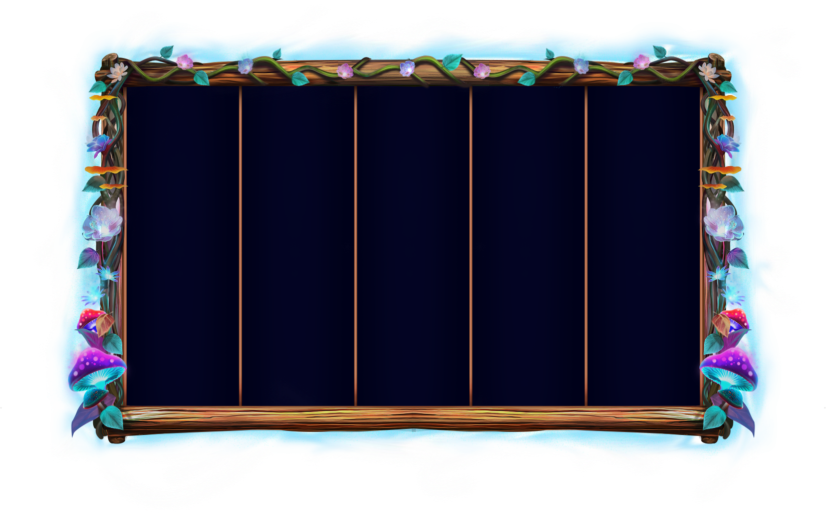
Game Reel

Slide 7
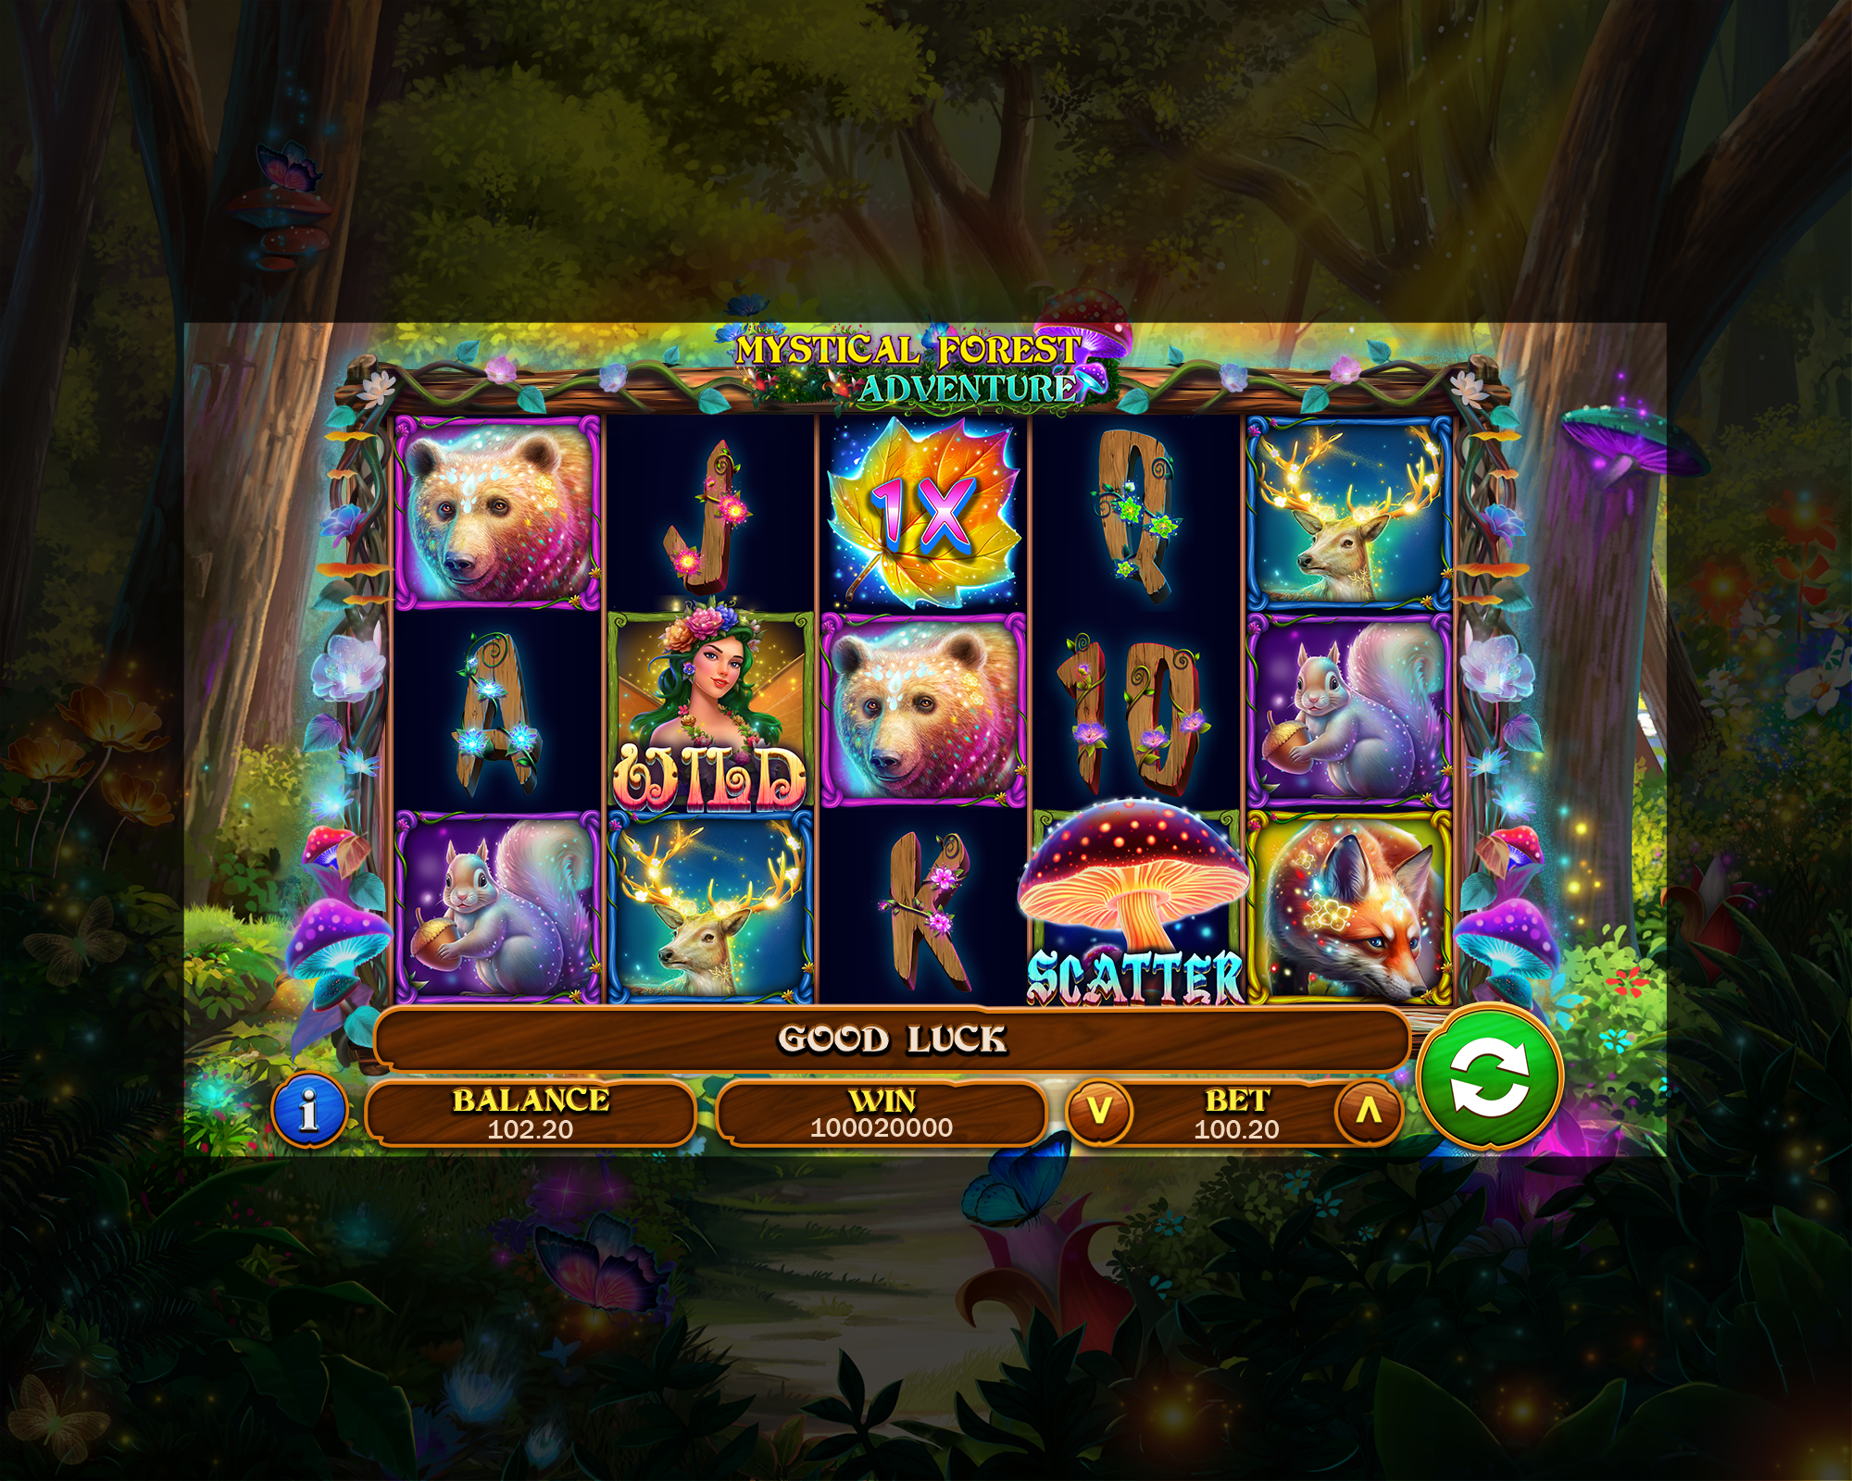
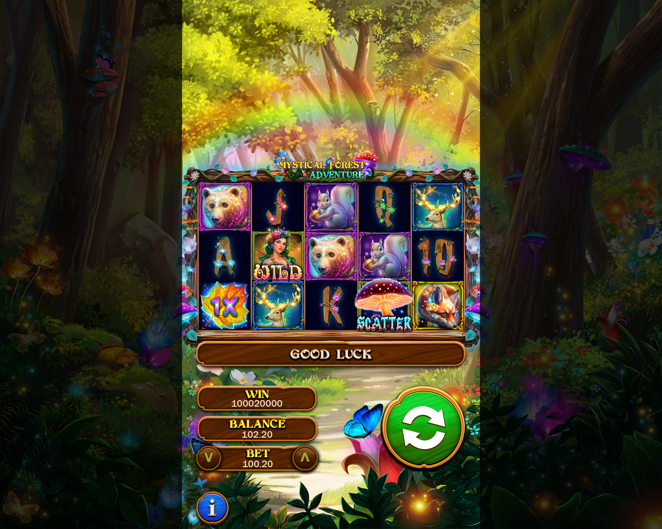
Game UI Mock-ups
Base Game
Landscape
Portrait

Slide 8












Symbol Hierarchy
Low
High
Wild
Bonus
Scatter

Slide 9
Special Symbol Introduction
Wild
Wild participates in all win except scatter/Bonus.
Land 3, 4 or 5 wilds in a payline to trigger a Wild win.

Slide 10
High Symbol Introduction
High 1
High 2
High 3
High 4

Slide 11
Low Symbol Introduction
Low 1
Low 2
Low 3
Low 4
Low

Slide 12
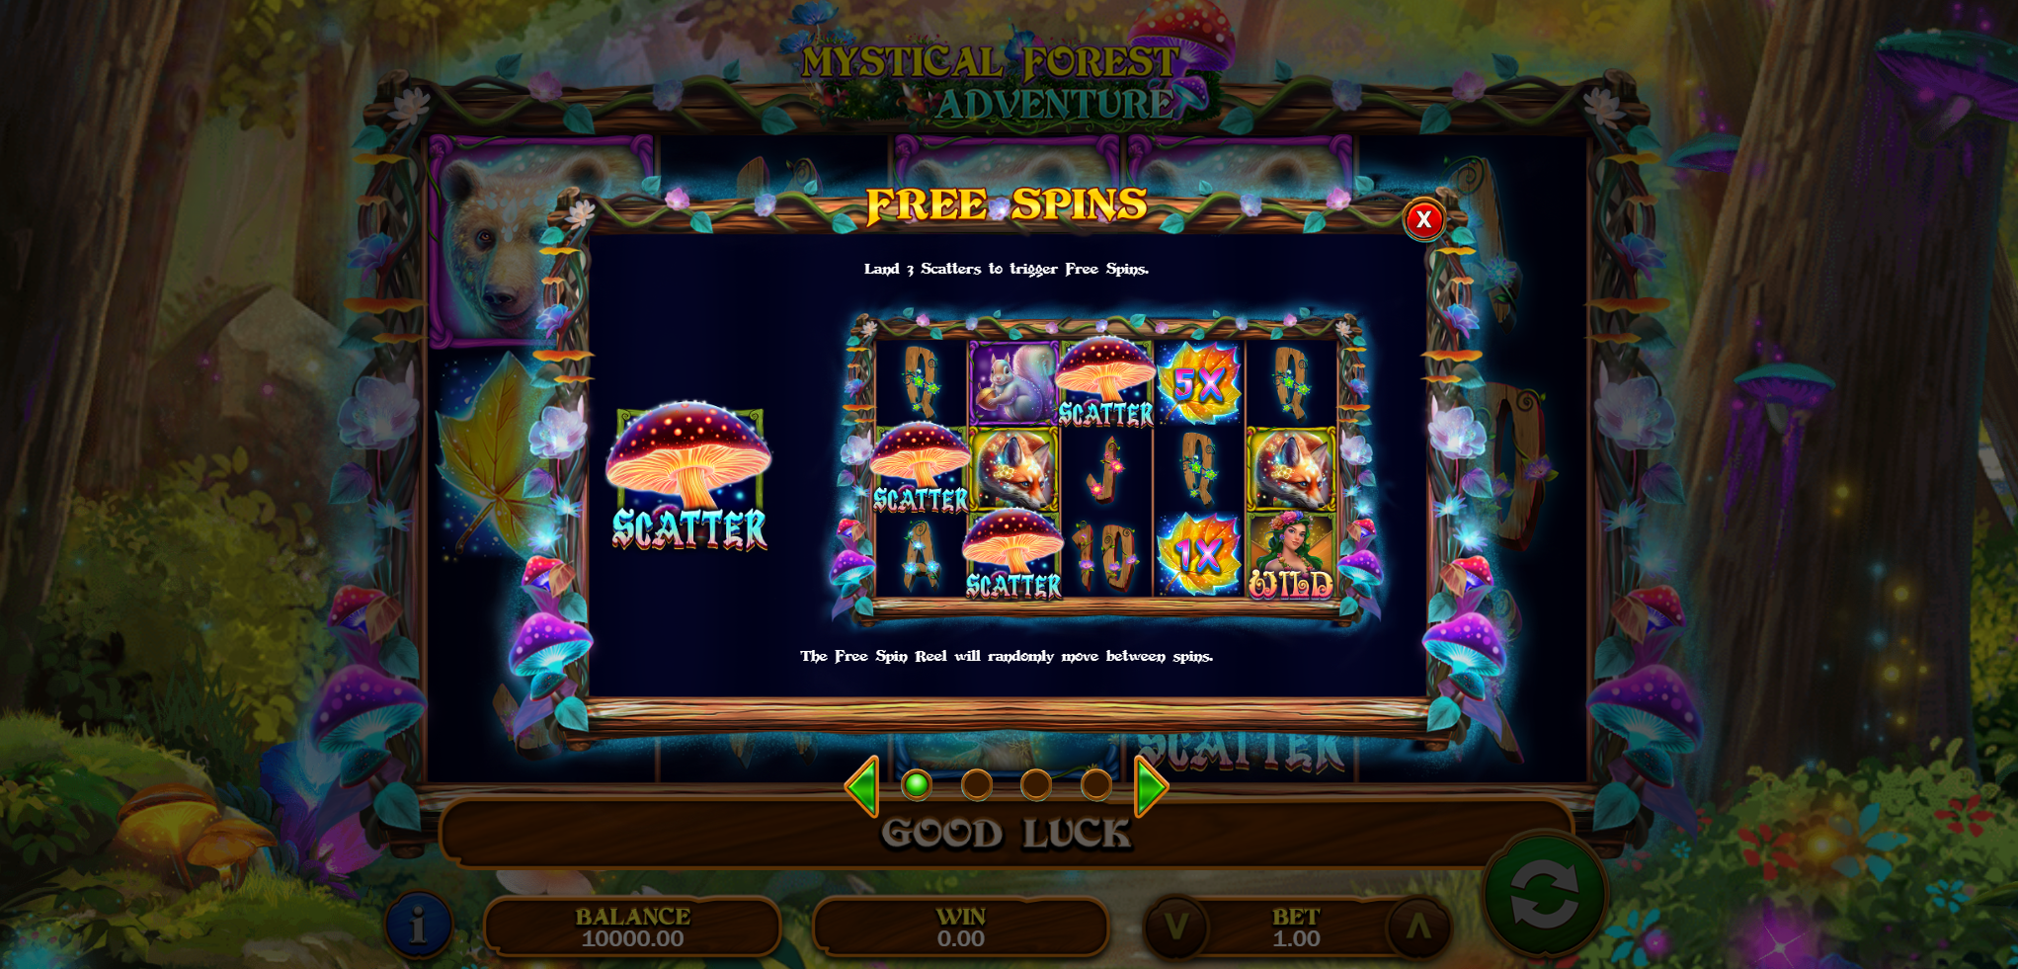
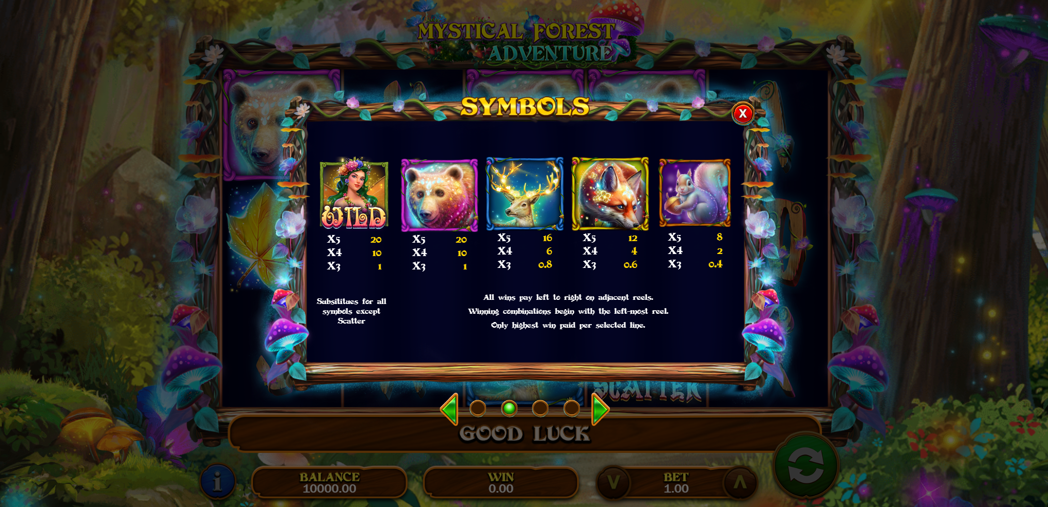
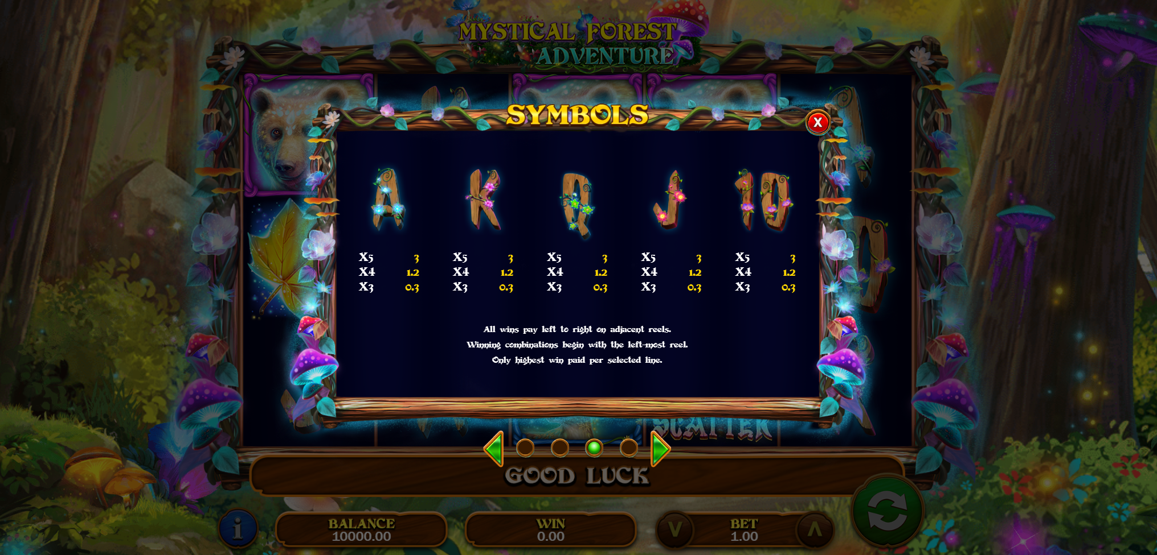
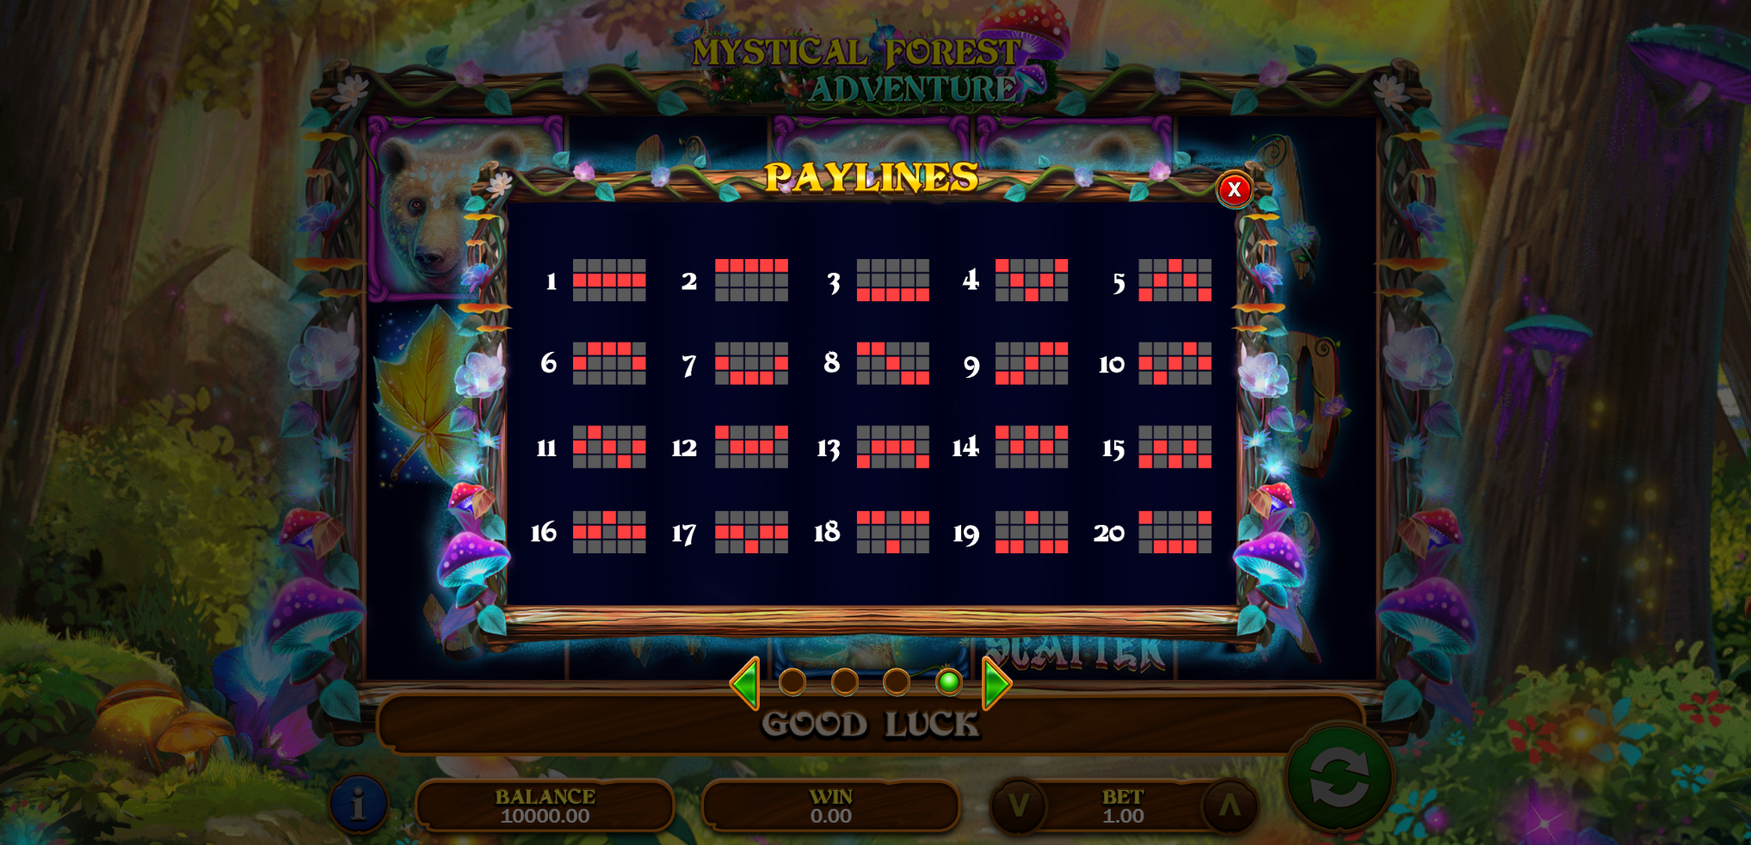
Info Panel

Slide 13

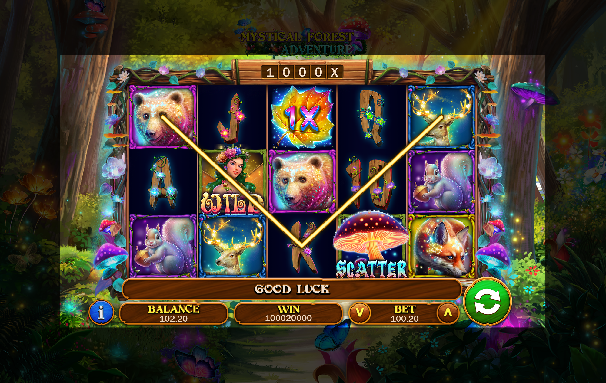
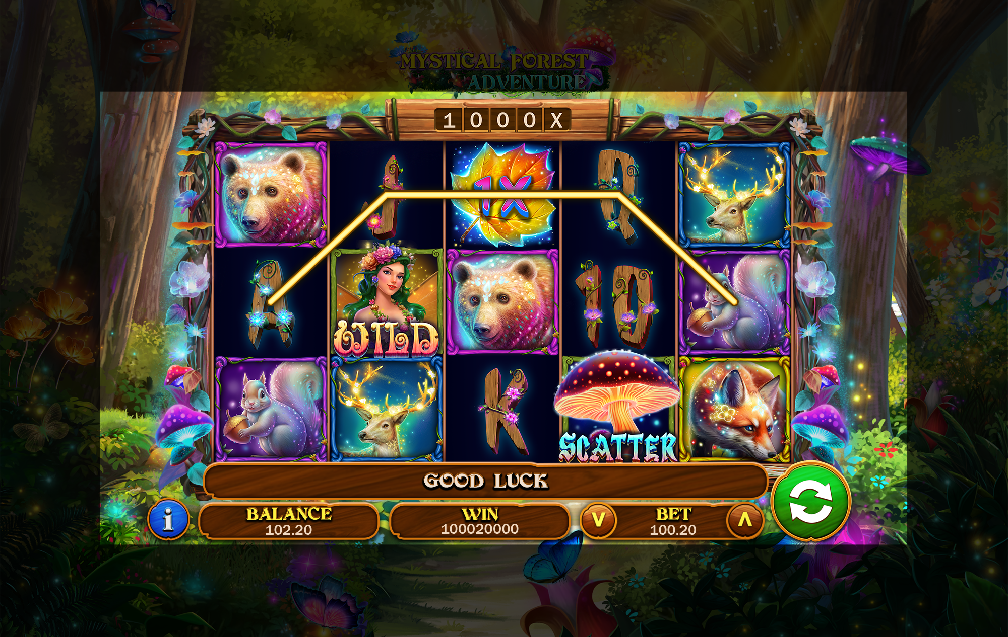
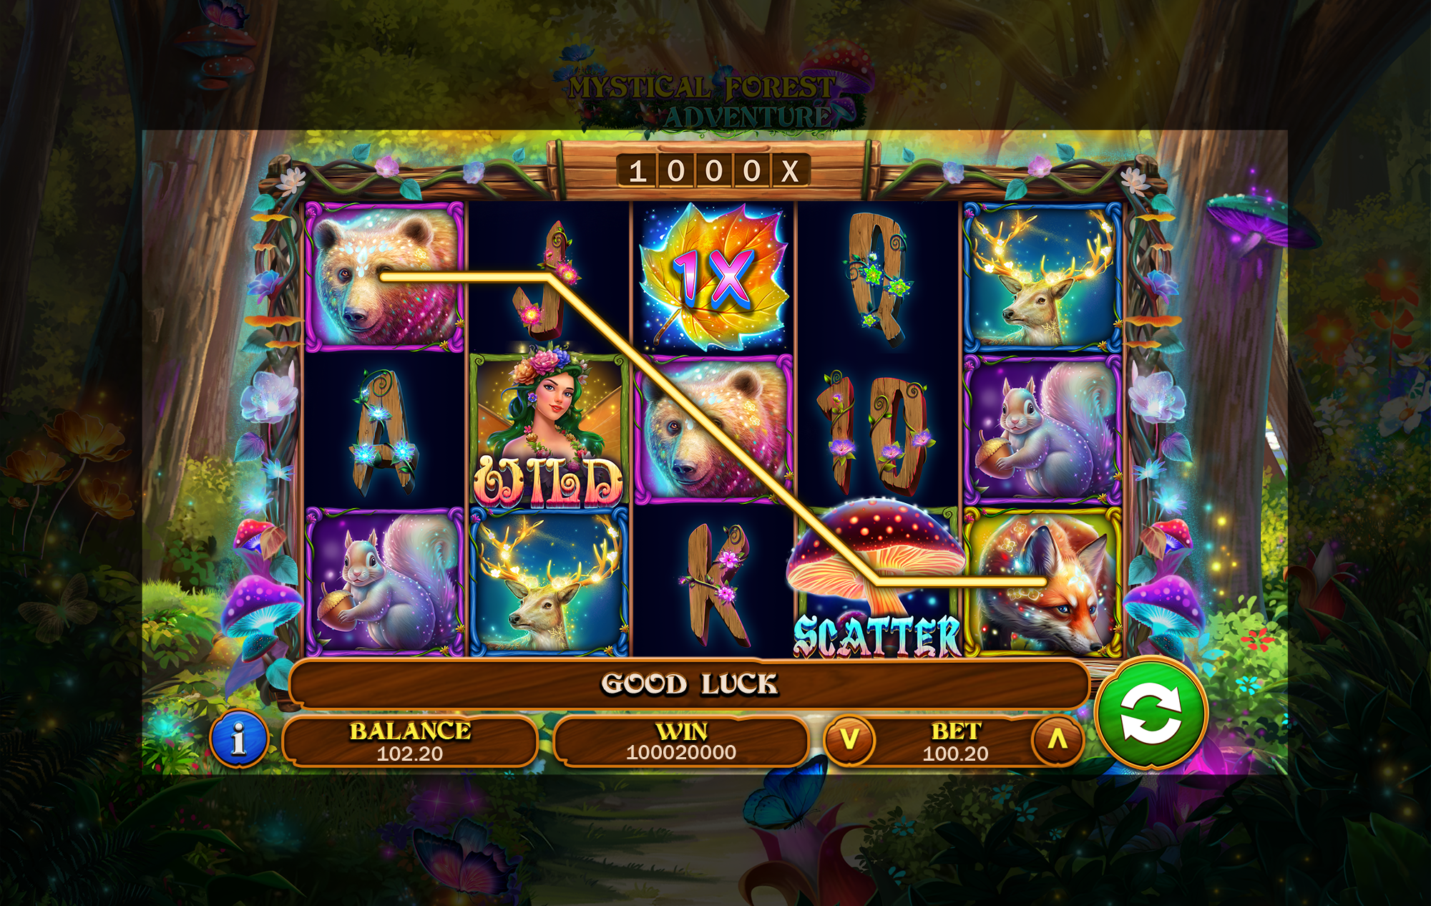
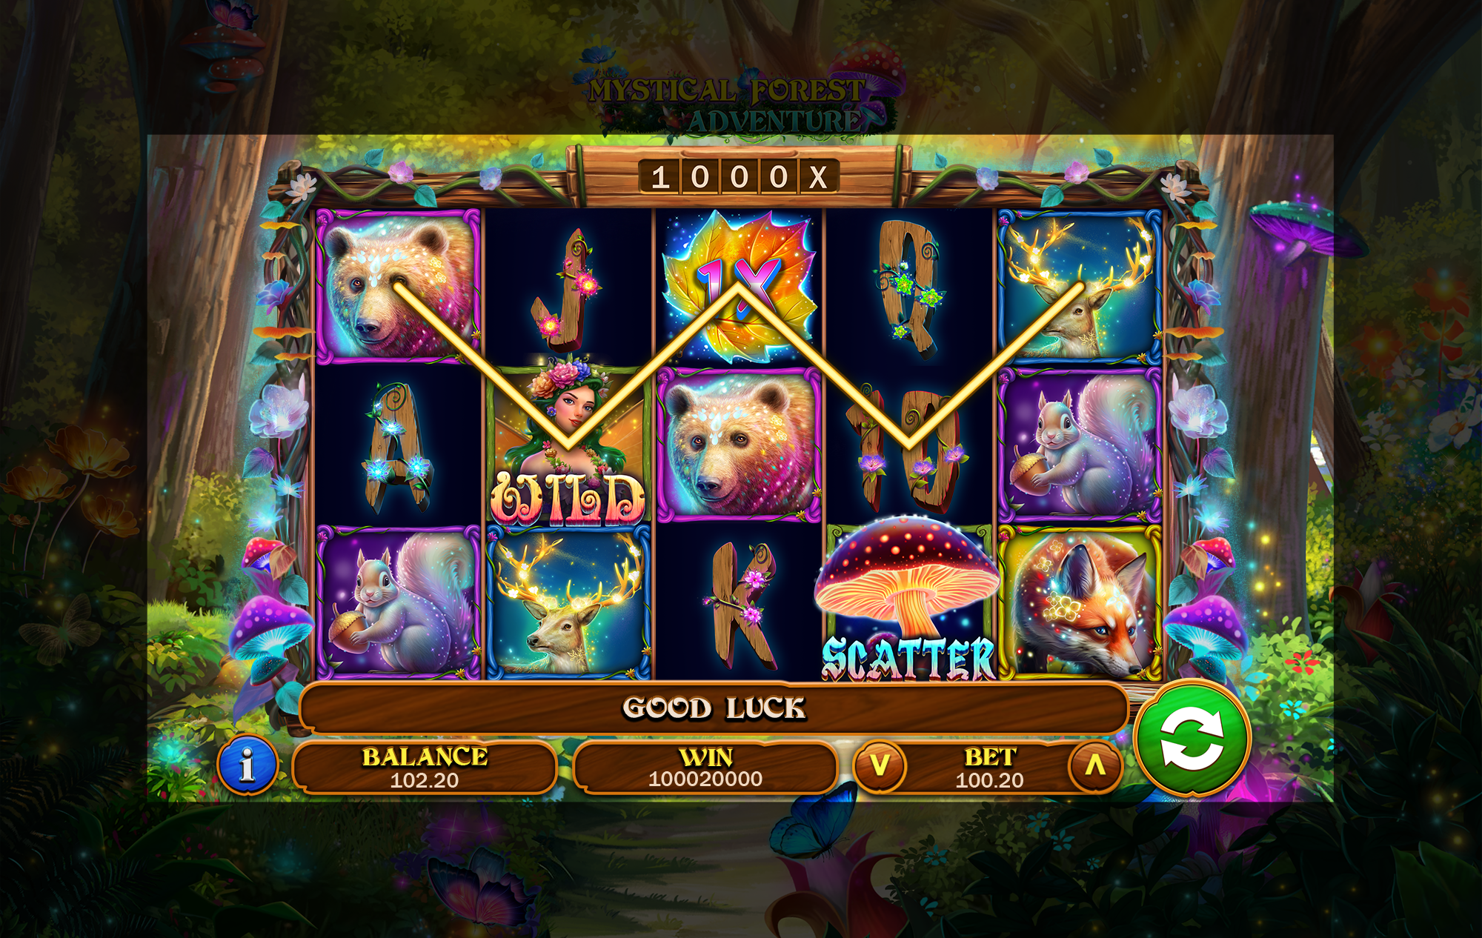
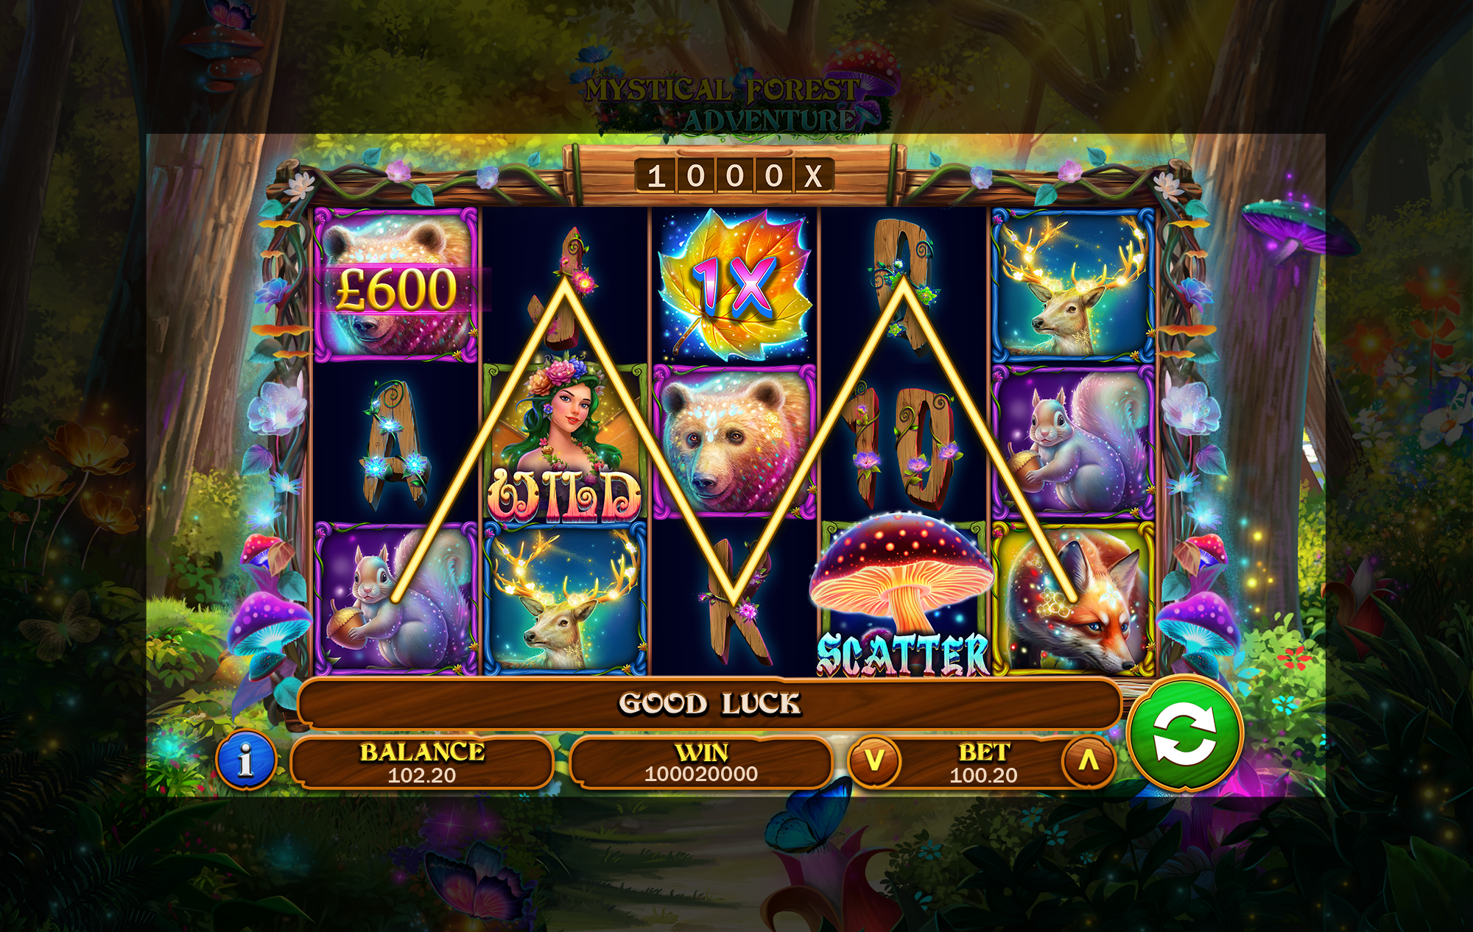
Win Lines

Slide 14
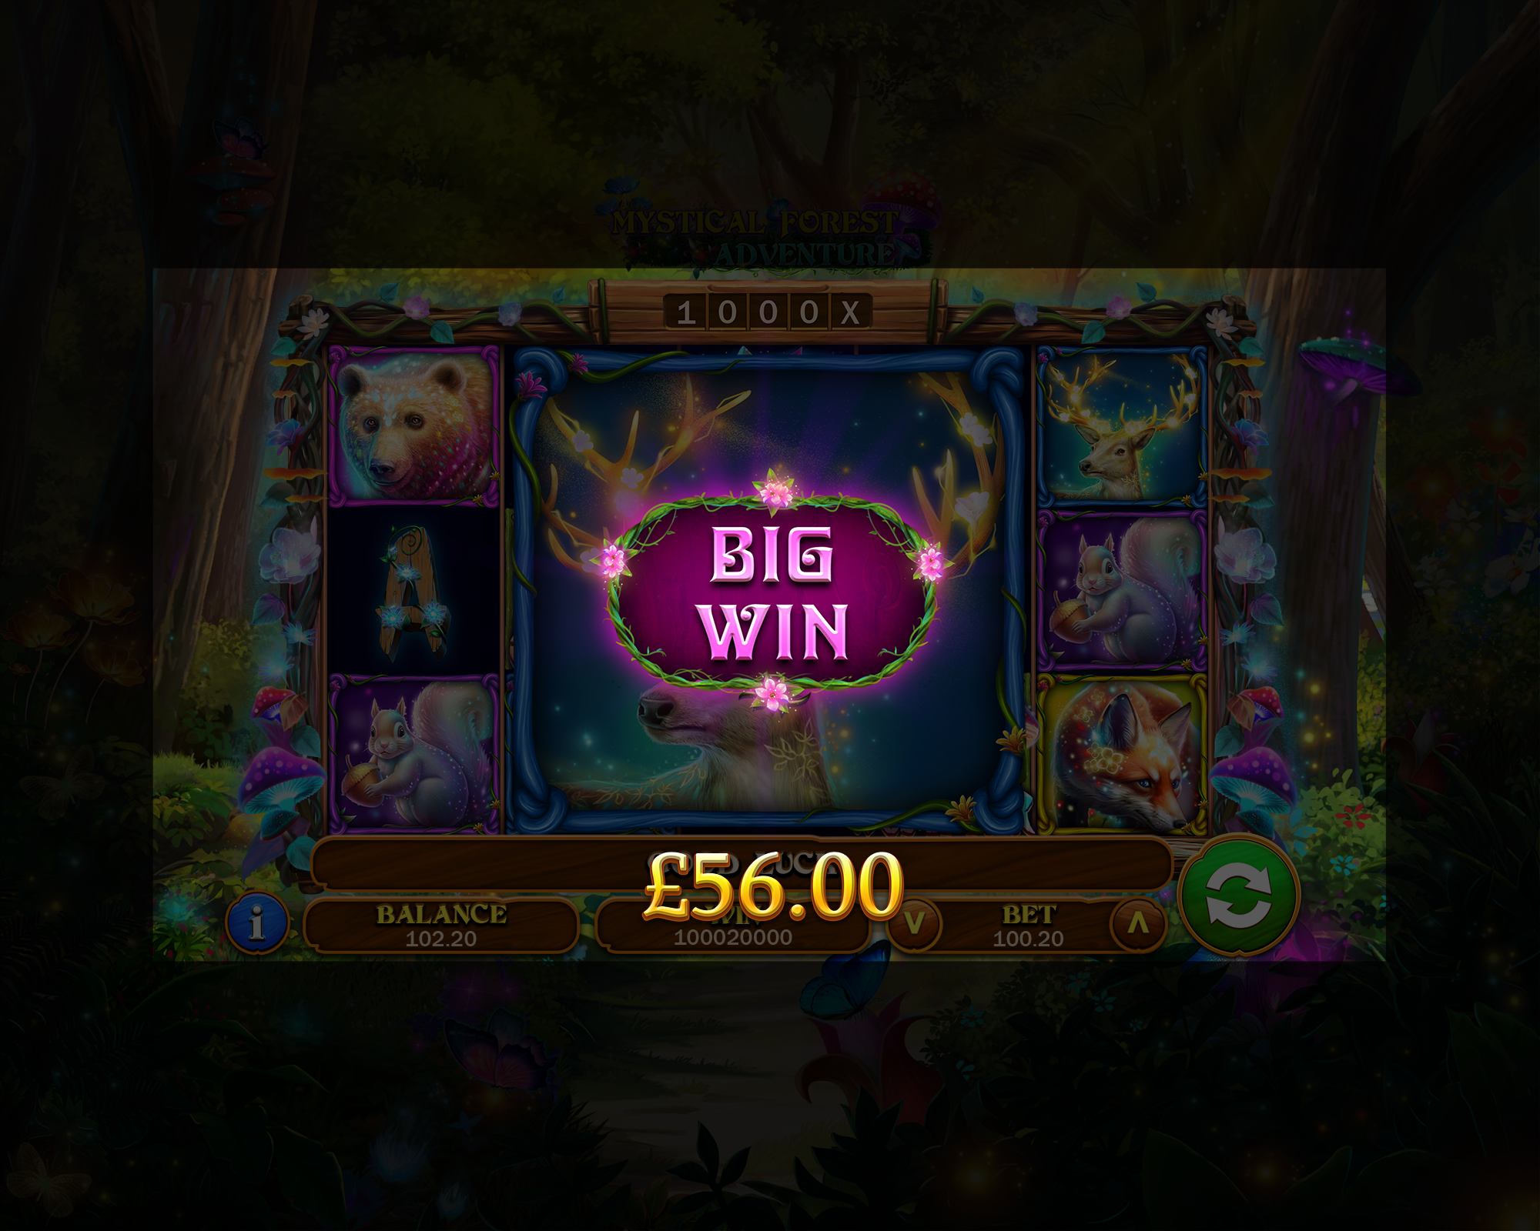
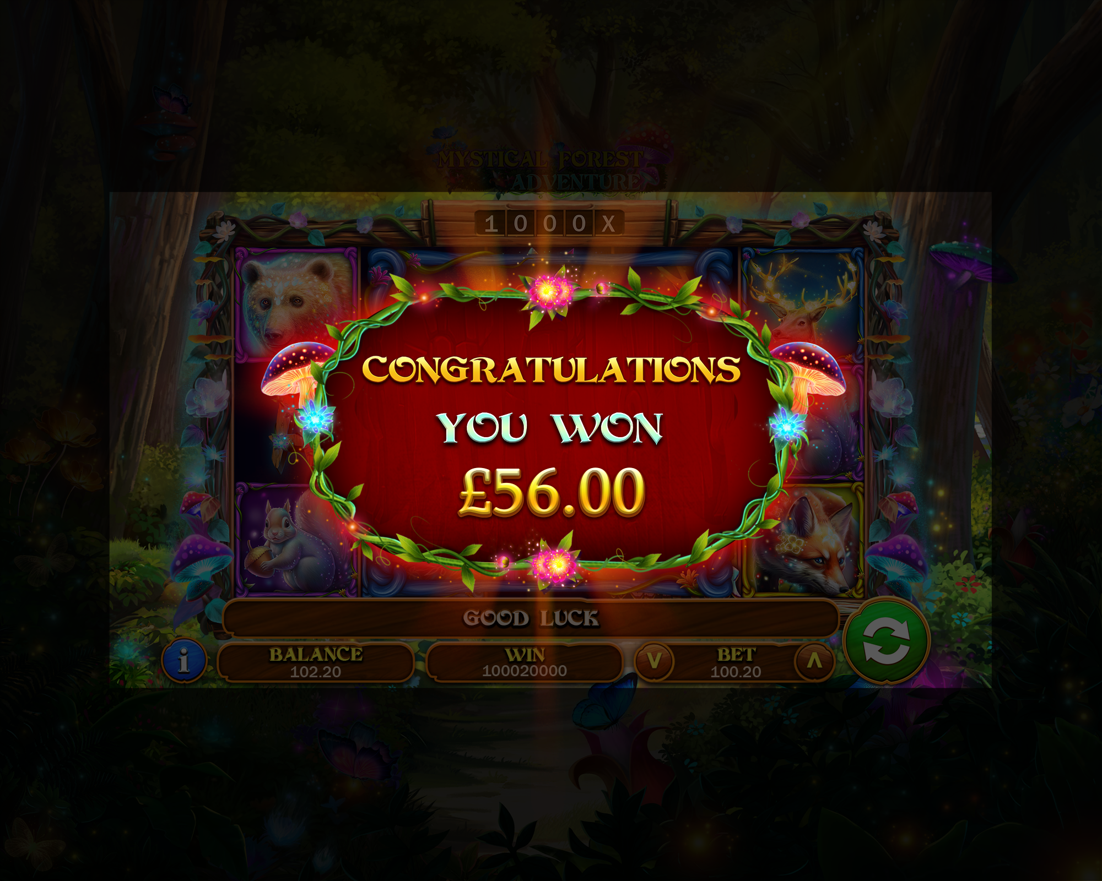
Win Messages

Slide 15


Loading Screen

Slide 16
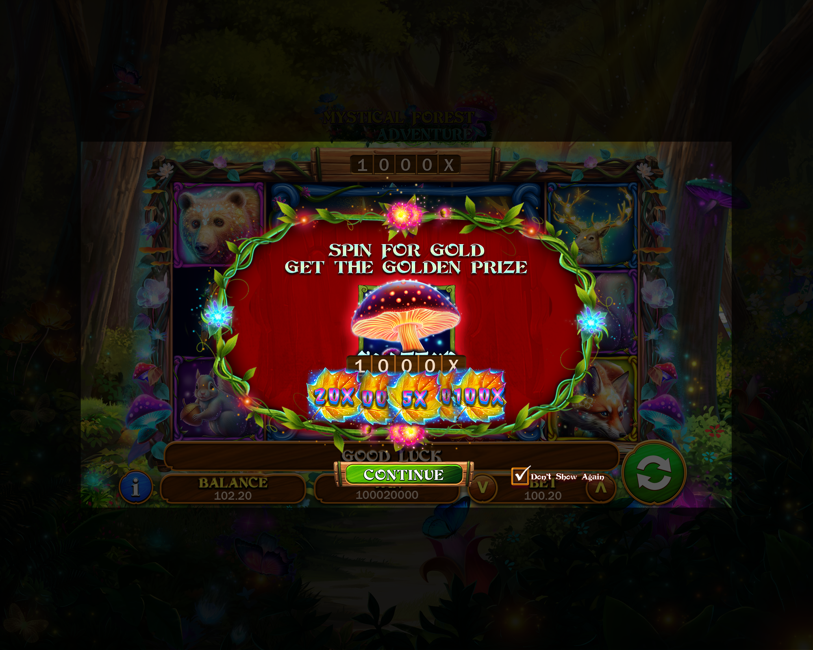
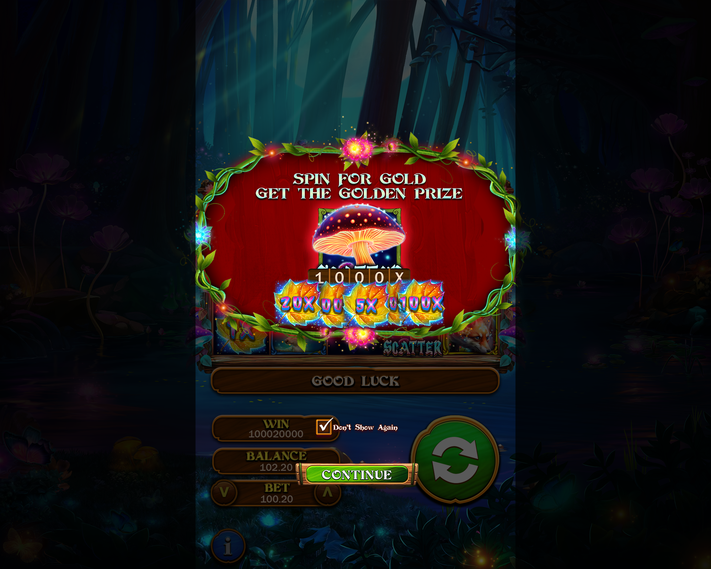
Splash Screen

Slide 17
Game Logo

